Slide 1
Digital Image Processing Lecture – Image Compression
Course Teacher:
Md. Rayhan Ahmed
Rayhan@cse.uiu.ac.bd

Slide 2
Data and Information
Data are the means by which information is conveyed.
Various amounts of data can be used to represent the same amount of information, representations that contain irrelevant or repeated information are said to contain redundant data.
Information is an interpretation of the data in a meaningful way. Information is an elusive concept; it can be application specific.
Data not equal to Information.
For digital images, data refers to the pixel gray level values that correspond to the brightness of a pixel at a point in space.
The term data compression refers to the process of reducing the amount of data required to represent a given quantity of information.

Slide 3
Image Compression
The field of image compression continues to grow at a rapid pace.
Image compression is a method that reduces the amount of memory it takes to store in image, while retaining necessary information.
Information retention depends on the applications.
As we look to the future, the need to store and transmit images will only continue to increase faster than the available capability to process all the data.
Applications that require image compression are many and varied such as:
Internet,
Businesses,
Multimedia,
Satellite imaging,
Medical imaging

Slide 4
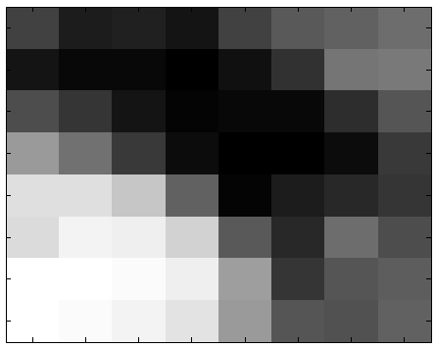
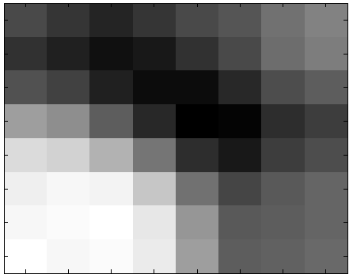
Can You Tell the Difference?
Original Compressed

Slide 5


Image Compression
Original Compressed

Slide 6
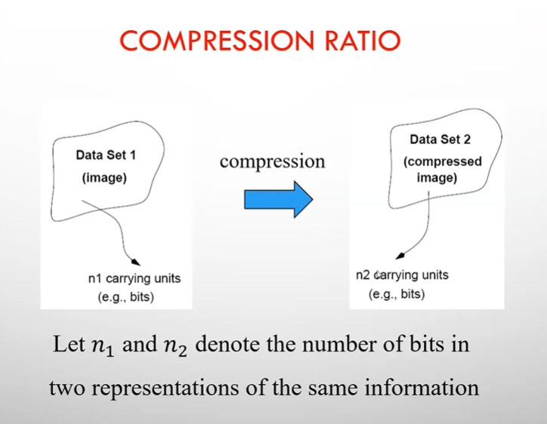
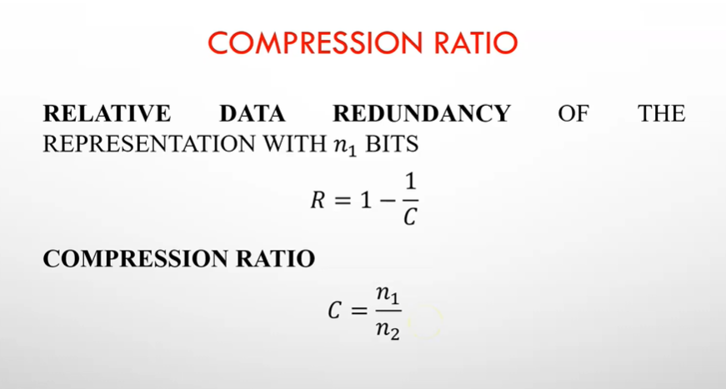
Image Compression
If C = 10 (sometimes written 10:1), for instance, the larger representation has 10 bits of data for every 1 bit of data in the smaller representation. The corresponding relative data redundancy of the larger representation is 0.9 (R = 0.9), indicating that 90% of its data is redundant.

Slide 7
Image Compression
The reduced file created by the compression process is called the compressed file and is used to reconstruct the image, resulting in the decompressed image
The original image, before any compression is performed, is called the uncompressed image file
The ratio of the original, uncompressed image file and the compressed file is referred to as the compression ratio

Slide 8

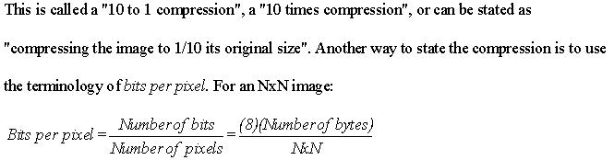
The compression ratio is denoted by:

Slide 9
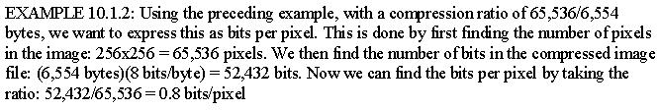
The reduction in file size is necessary to meet the bandwidth requirements for many transmission systems, and for the storage requirements in computer databases
Also, the amount of data required for digital images is enormous

Slide 10
Image Compression
There are two primary types of image compression methods:
Lossless compression methods:
Allows for the exact recreation of the original image data, and can compress complex images to a maximum 1/2 to 1/3 the original size – 2:1 to 3:1 compression ratios.
Preserves the data exactly.
Lossy compression methods:
Data loss, original image cannot be re-created exactly
Can compress complex images 10:1 to 50:1 and retain high quality, and 100 to 200 times for lower quality, but acceptable, images

Slide 11
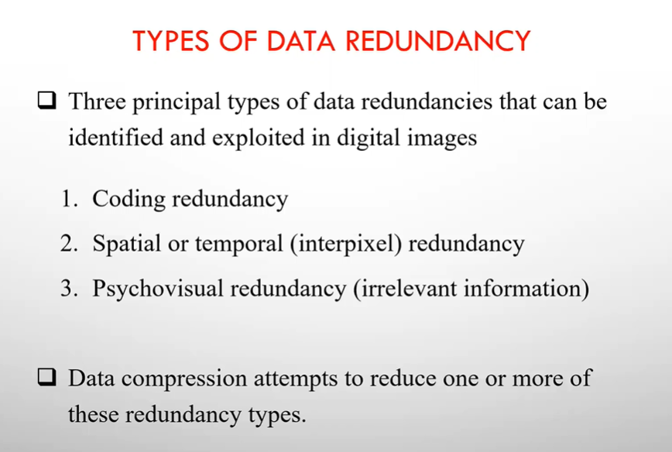
Image Compression

Slide 12
Types of data redundancy
Coding redundancy: A code is a system of symbols (letters, numbers, bits, and the like) used to represent a body of information or set of events. Each piece of information or event is assigned a sequence of code symbols, called a code word. The number of symbols in each code word is its length. The 8-bit codes that are used to represent the intensities in most 2-D intensity arrays contain more bits than are needed to represent the intensities
Spatial and temporal redundancy: Because the pixels of most 2-D intensity arrays are correlated spatially (i.e., each pixel is similar to or dependent upon neighboring pixels), information is unnecessarily replicated in the representations of the correlated pixels. In a video sequence, temporally correlated pixels (i.e., those similar to or dependent upon pixels in nearby frames) also duplicate information.
Irrelevant information: Most 2-D intensity arrays contain information that is ignored by the human visual system and/or extraneous to the intended use of the image. It is redundant in the sense that it is not used.

Slide 13

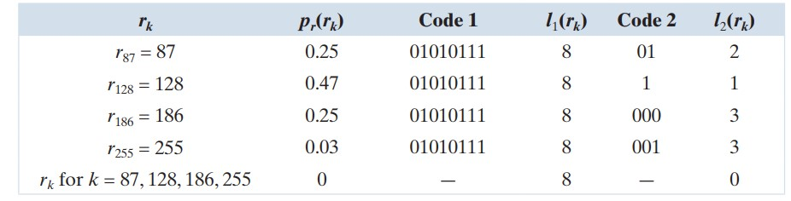
Coding redundancy - basics

Slide 14
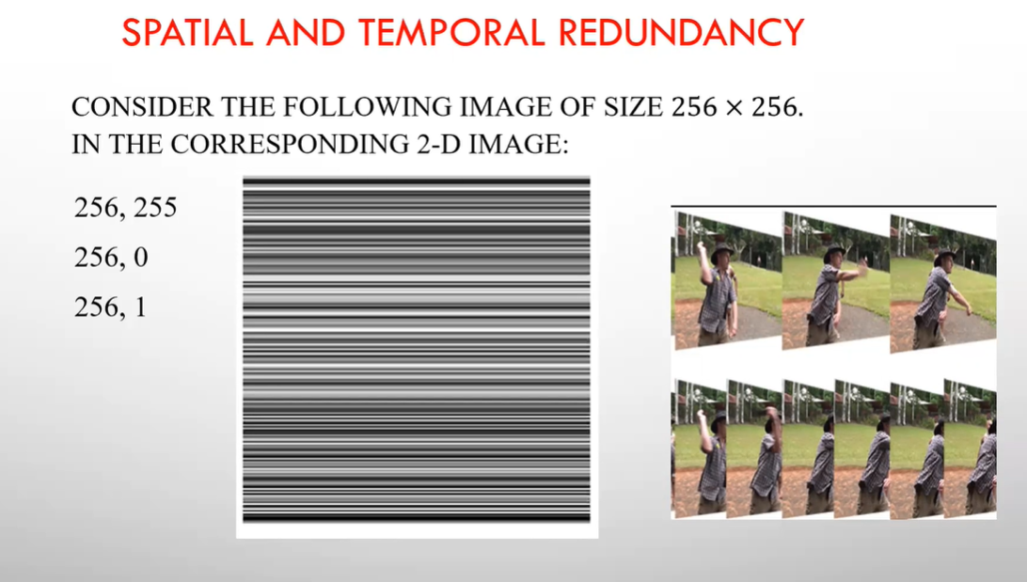
Spatial and temporal redundancy

Slide 15
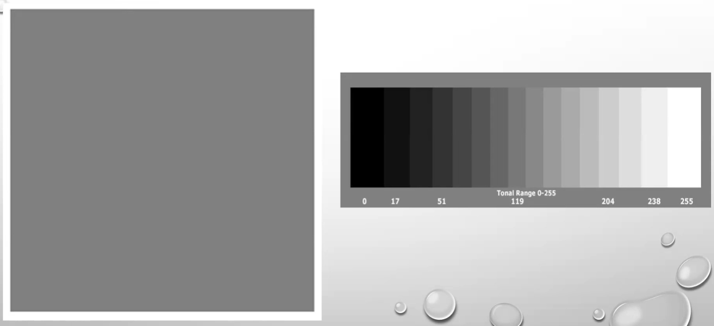
Irrelevant information

Slide 16
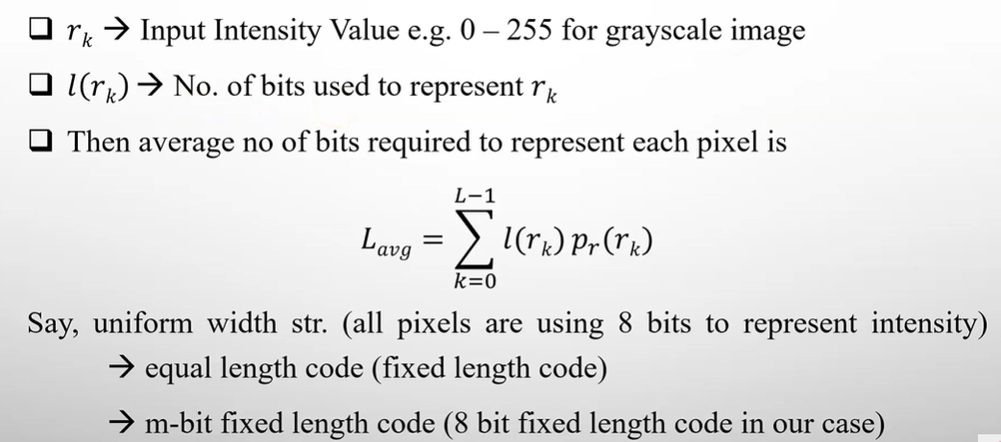
Coding redundancy

Slide 17
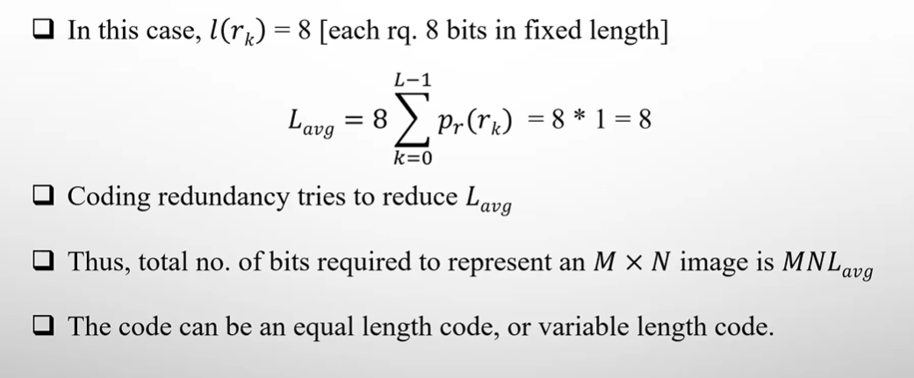
Coding redundancy

Slide 18
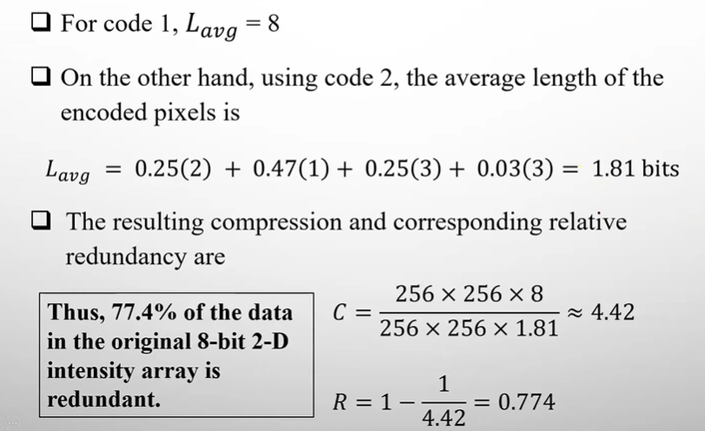
Coding redundancy

Slide 19
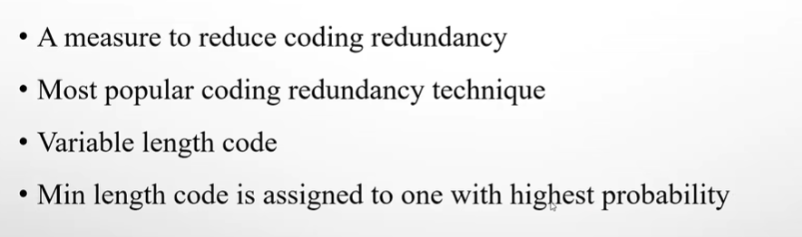
Coding redundancy – Huffman Coding

Slide 20
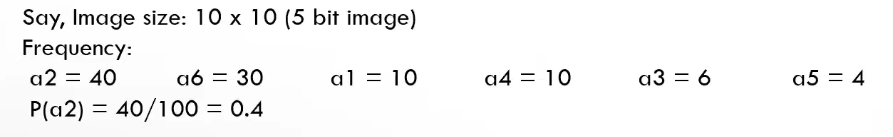
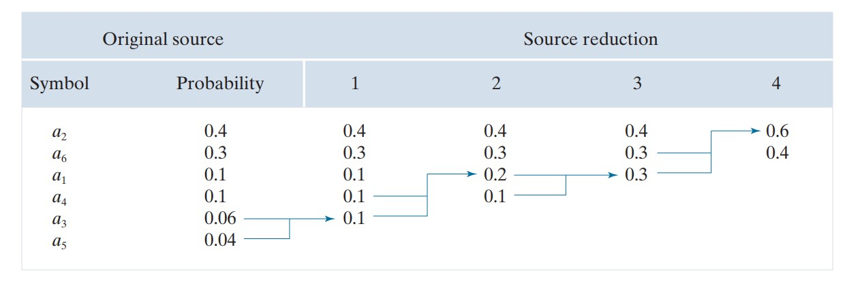
Huffman Coding

Slide 21
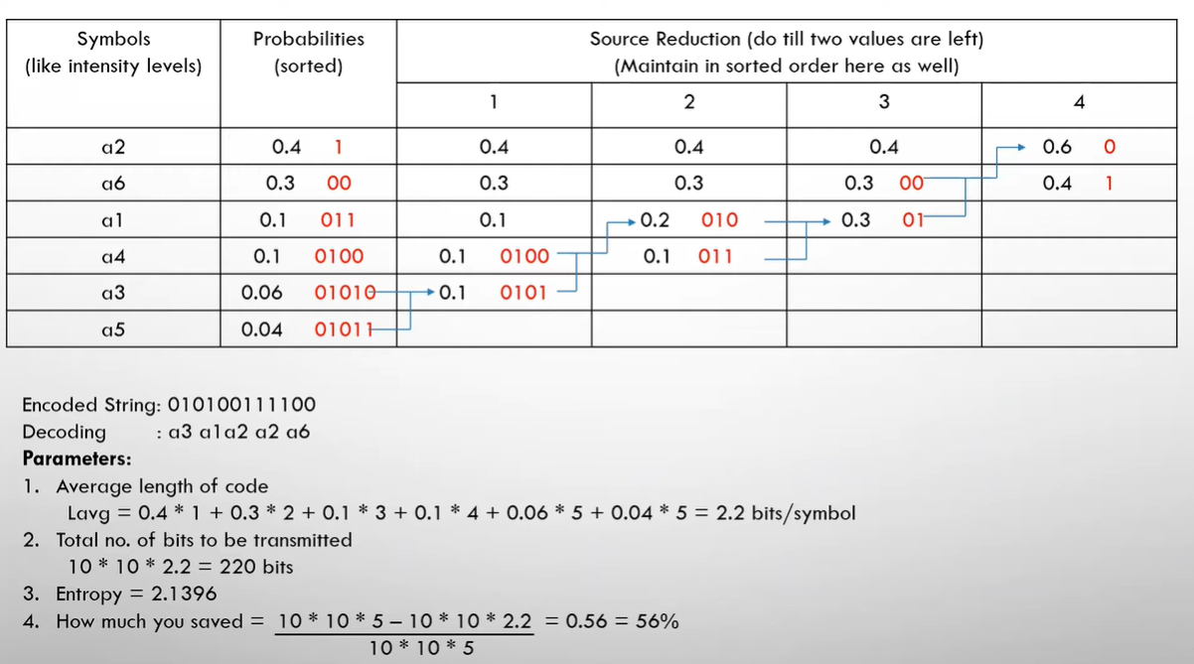
Huffman Coding

Slide 22
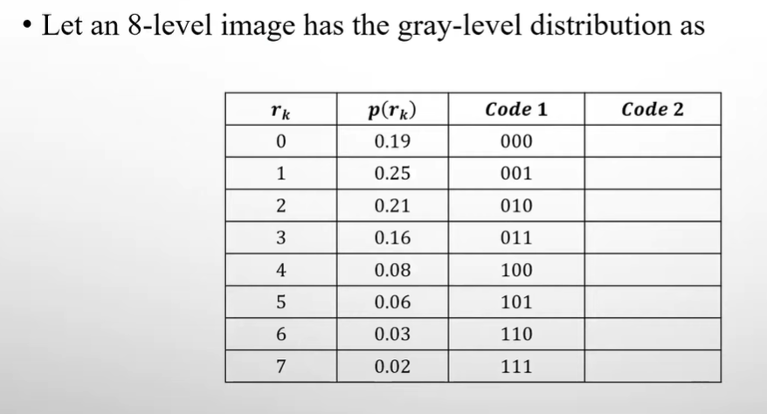
Huffman Coding - Exercise

